Slide 1
Attendence Management System
Marwa Mohamed samy Mohamed maram nasser farid
Habiba amr ali Habiba abdelsamea abdelhamed
Aya yousry Aboelabas Mohamed sayed ali
Mohamed adel Mohamed

Slide 2
Brief about the project:
A student attendance management system is a software tool that assists educational institutions in tracking and managing student attendance effectively . tracks student attendance without using paper .

Slide 3
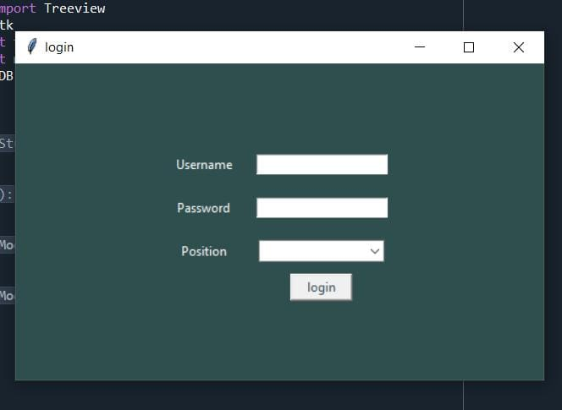
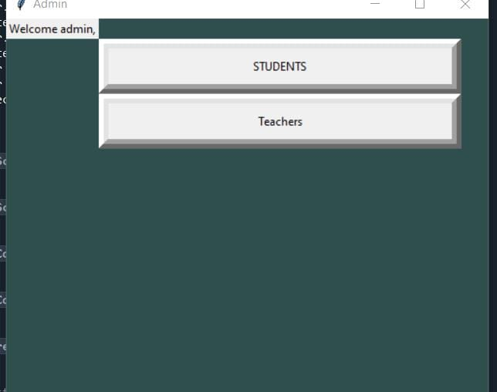
This frame is used to check your username and password and give you access to the system if you are a student, teacher or admin.
In this frame if you chose admin then you will choose which one (student or teacher) you want to add,delete or edit in it.

Slide 4
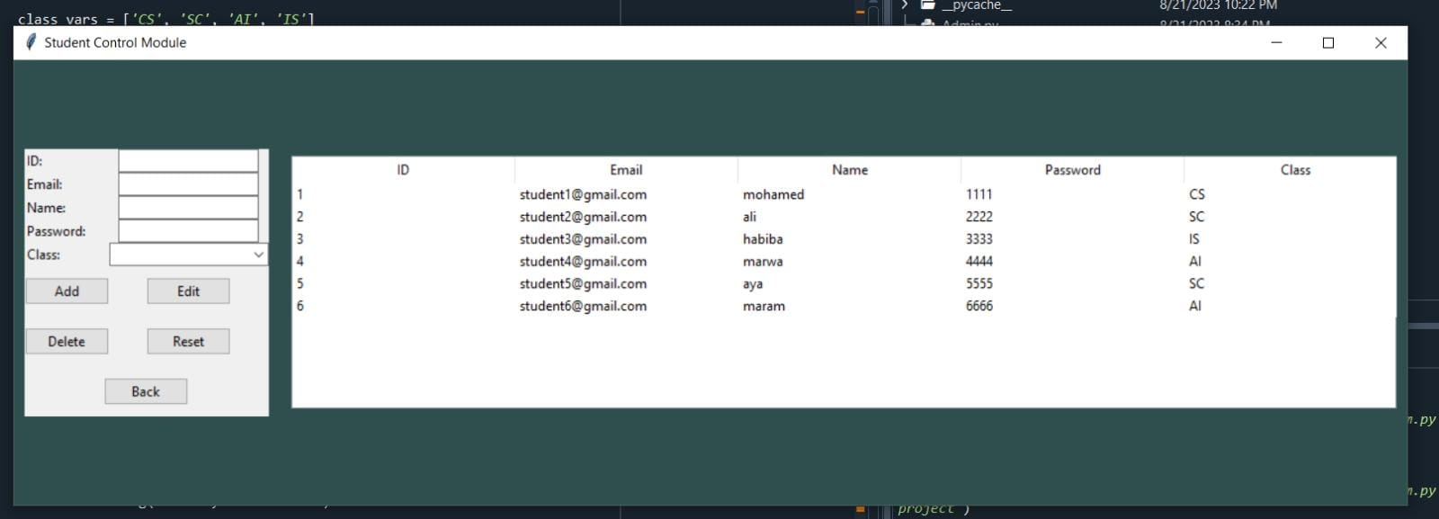
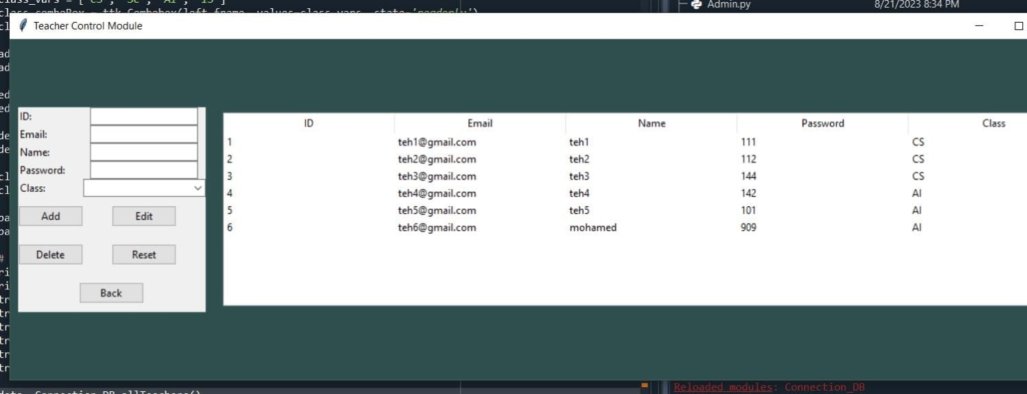
In this frame the admin is allowed to add student edit or delete its data.
In this frame the admin is allowed to add teacher edit or delete its data.

Slide 5
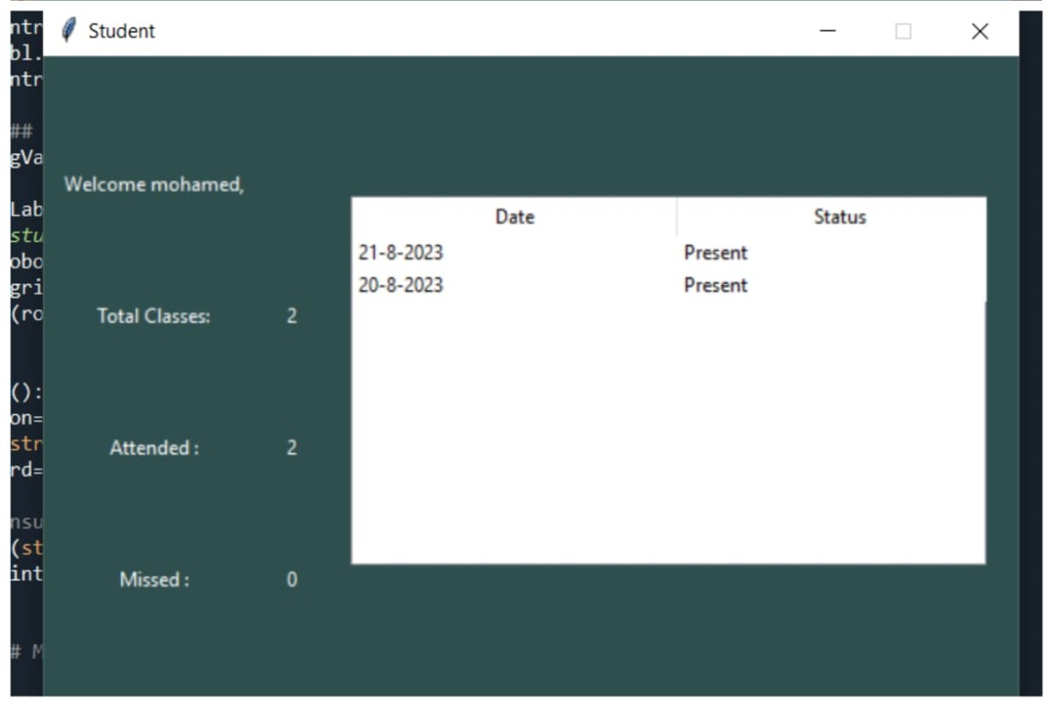
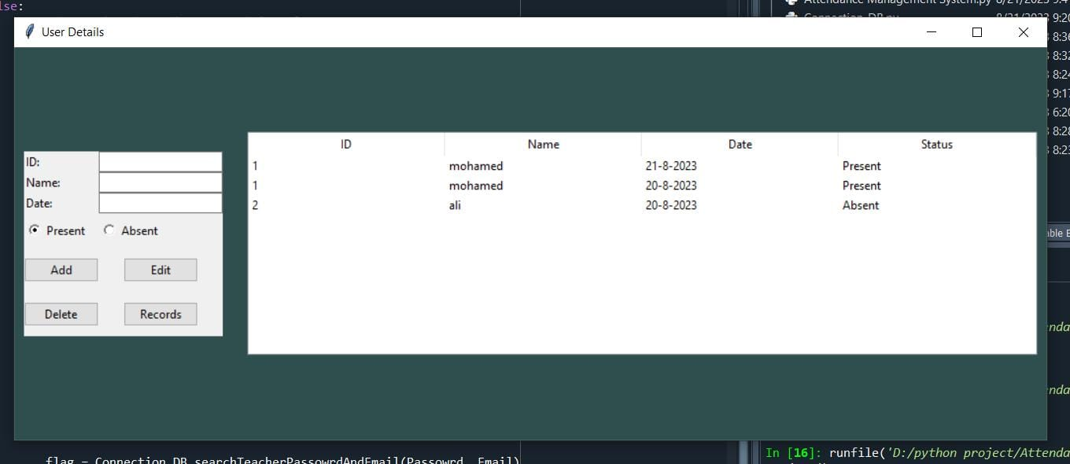
In this frame if chose student then you will move to this frame which shows you details about your attendance.
in this frame if you are teacher you are allowed to add a student delete or edit or see his records.

Slide 6
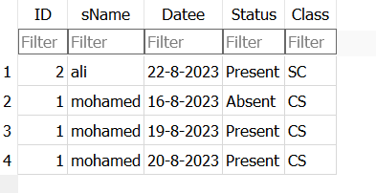
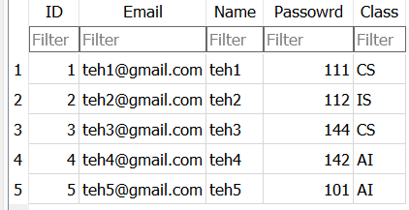
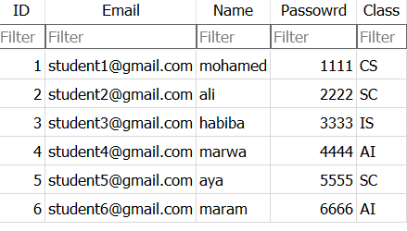
Teachers table in database.
Attendence table in database.
Students table in database.

Slide 7
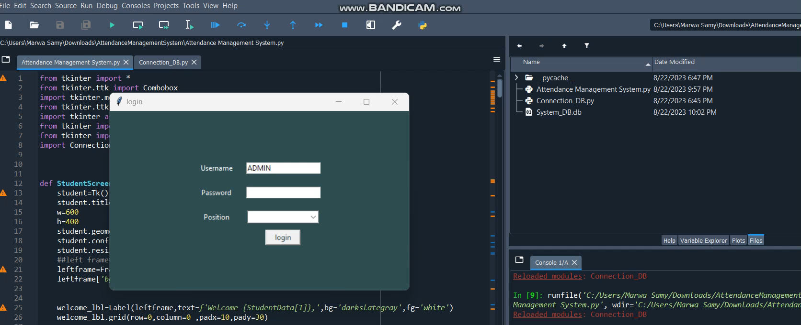

Slide 8
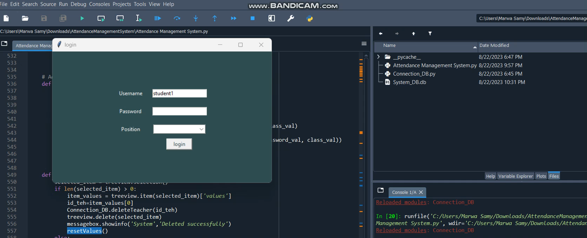

Slide 9
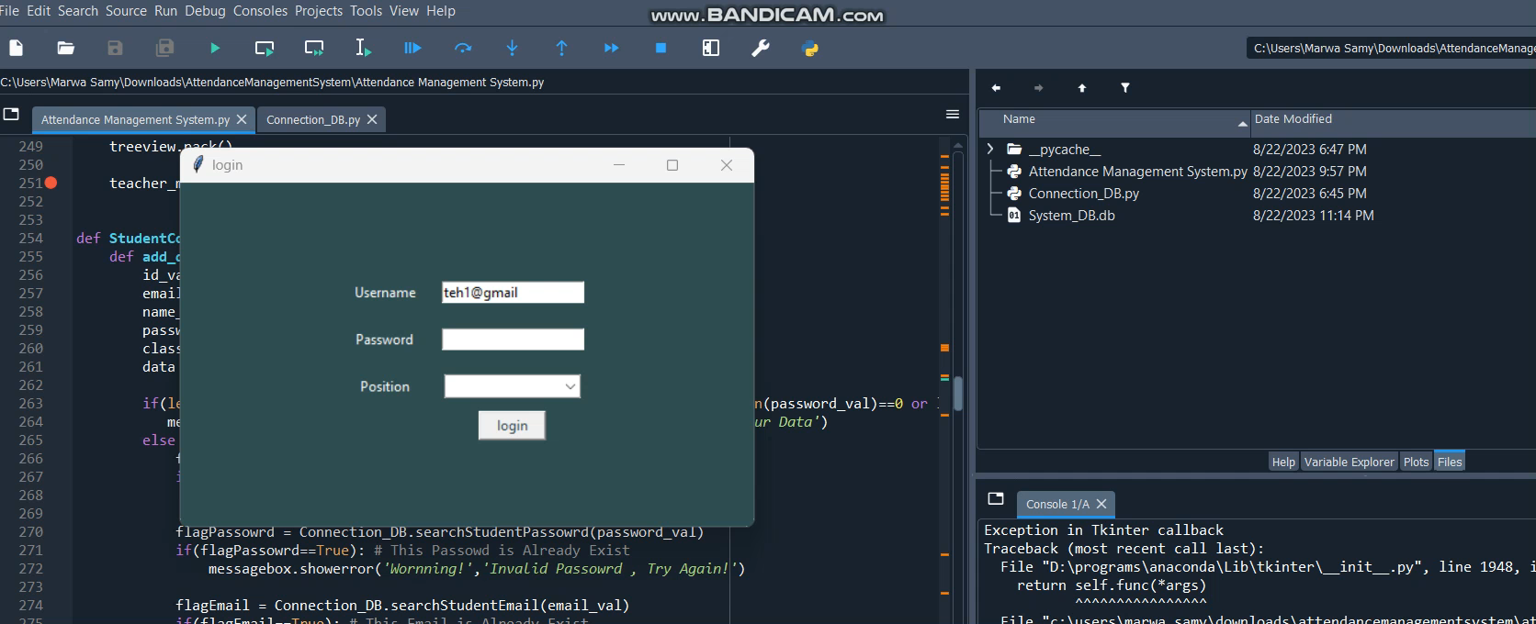

Slide 10
Thank You

